Slide 1

Affordable Solution to Automated Insulin Pumps
COLLABORATIVE CARE: INSULIN PUMP
Jake Carter, Carolyn Savas, Jordan Simpson

Slide 2


Insulin Pumps
a pricey solution for diabetics
The most precise measurement of short term and long term glucose
Best blood sugar correction technique
Delivers constant correction
Convenient

Slide 3
Insulin Pumps
a pricey solution for diabetics
Insulin pumps cost $4,500 to $6,500 just for hardware
Insurance unwilling to cover the cost
Individuals without coverage
using traditional, less precise techniques

Slide 4

Collaborative Care
the healthcare market reimagined as open source

Slide 5
What is the Collaborative Care model?
TRADITIONAL HEALTHCARE | COLLABORATIVE CARE
High development cost Accounts for inflated medical cost Custom hardware and software | Eliminate development cost Open source software/hardware
Exclusive Monopolies Product made to profit | Inclusive Open source = infinite modification Product is made to help people

Slide 6
Arduino Insulin Pump
an affordable solution
HARDWARE | PRICE ESTIMATE
Arduino Board/Parts | $40
Small Liquid Pump | $20
Tubes | $10
Insulin Reservoir | $20
Blood Sugar Sensor | $300
Unknown cost | $1,000
TOTAL | $1,400
69% PRICE DECREASE FROM $4,500

Slide 7
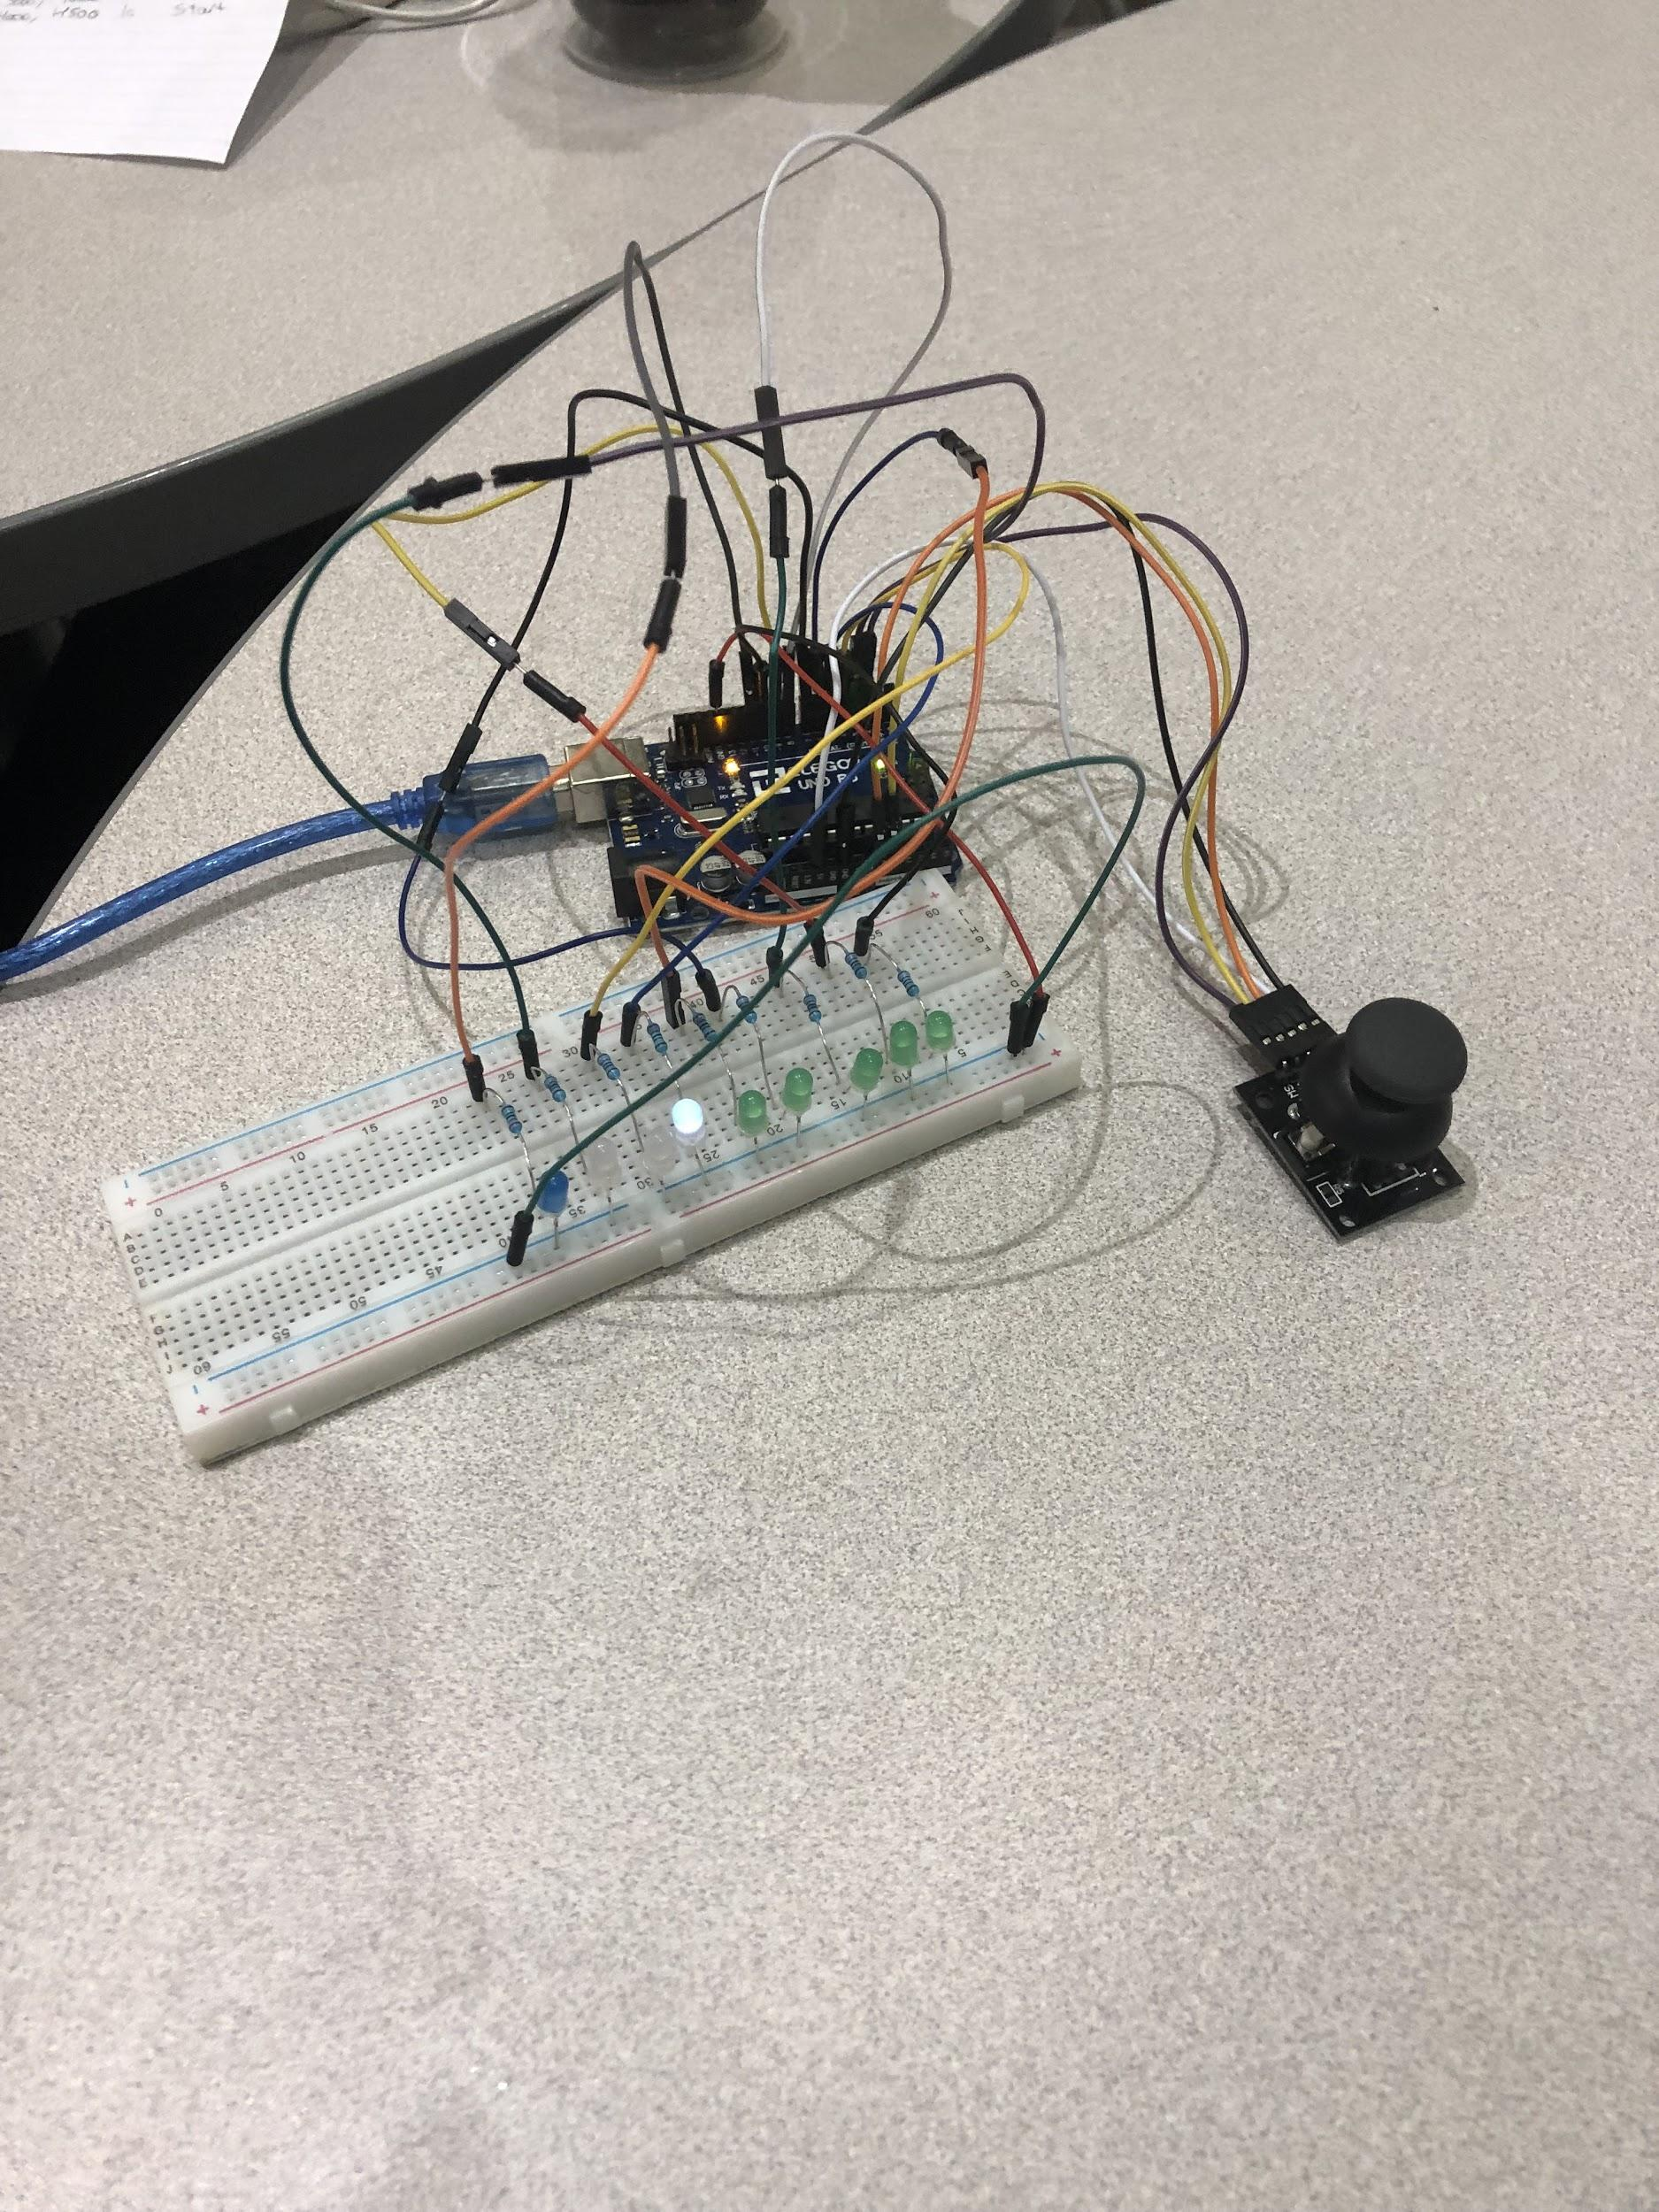
How the Collaborative Care Pump Works
Use joystick to simulate blood sugar levels
Move up = high levels, like eating
Arduino simulates pumping insulin
Blood sugar high, Lights moving = insulin pumping
App tracks levels throughout day
Notifies you if levels are too low
Tells arduino if you are about to eat so it will prep insulin

Slide 8
Future Plans
Hardware complete
Real insulin pump
Completely integrate sensor, arduino, and app
Create app
Plots blood sugar throughout day
Carbohydrates estimator
Weight watchers
Carbs on box
Send text notification to emergency contact/physician
ALL HEALTHCARE BECOME COLLABORATIVE CARE

